Slide 1

Airbnb – Washington DC Orkhon Boldbaatar

Slide 2
Intro
Airbnb, more than just a vacation rental company, was one of the market disruptors that started in 2008 which destabilized the hotel industry and changed the way people traveled by offering more options in booking places to stay. It got so popular that more and more people started using it as a business which eventually led to certain cities to put in place regulations on short term rentals.
Data:
One of those cities is Washington, D.C and I obtained my data from insideairbnb.com, an independent non-commercial project that gathers publicly available Airbnb information with the express purpose of promoting awareness on this issue of Airbnb adversely affecting local neighborhoods and established real-estate businesses. The dataset only provided listings that were available for the last 12 months in Washington, D.C.
The main dataset I will be working with is the listings data which includes fields like listings, coordinate location, neighborhood, price per night, room type, number of reviews, and availability days per year data on 39 neighborhoods that make up 8 Wards of Washington, D.C.
Image sources: https://en.wikipedia.org/wiki/Neighborhoods_in_Washington,_D.C.
Objective:
With that in mind, through this project I wanted to explore 2 questions particularly in the current post Covid state:
1) As a potential guest, where are the more affordable yet well rated and reviewed listings?
2) As a potential host, which area has the most demand and likelihood of occupancy in the D.C market for listings?

Slide 3
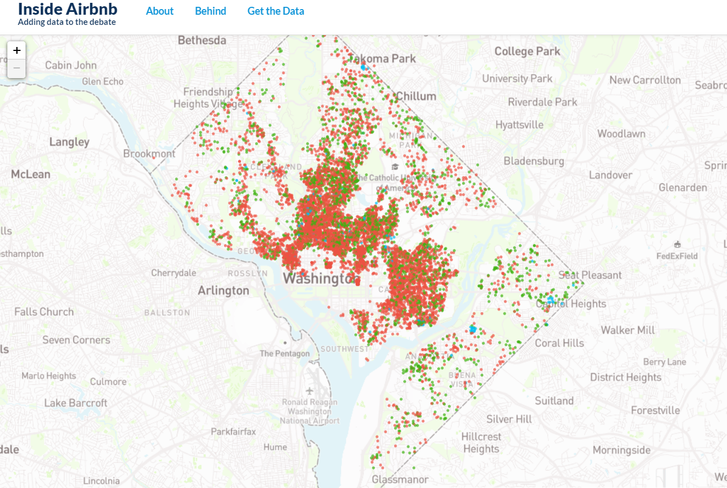

Slide 4
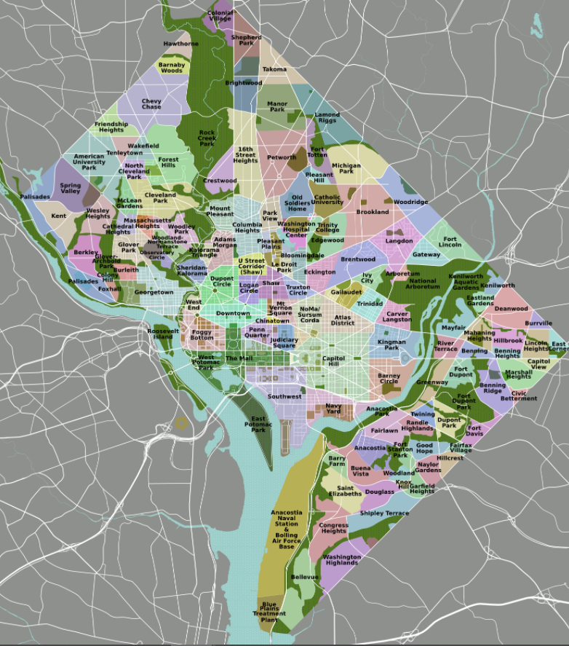
Challenge: 39 neighborhoods and no borough

Slide 5
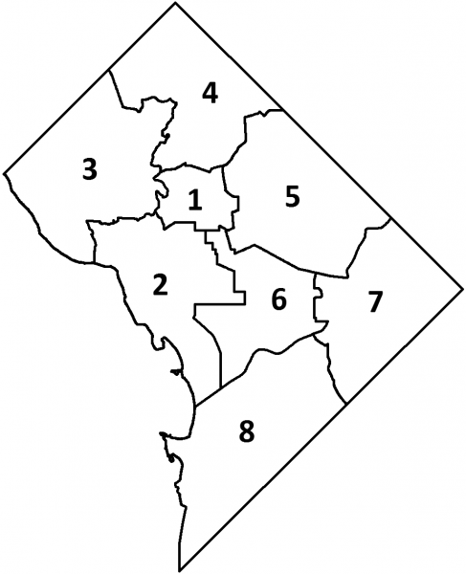
Wards
Historically, DC divides the neighborhoods into wards.
So added this info into my dataset to group the neighborhoods for trends.

Slide 6
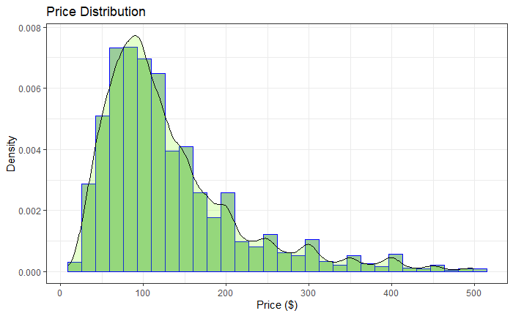
General Distribution of the Prices to get a feel for the pricing landscape: Because 94% of listings fall under $500 per night, I plotted the distribution within this range for better visibility.

Slide 7
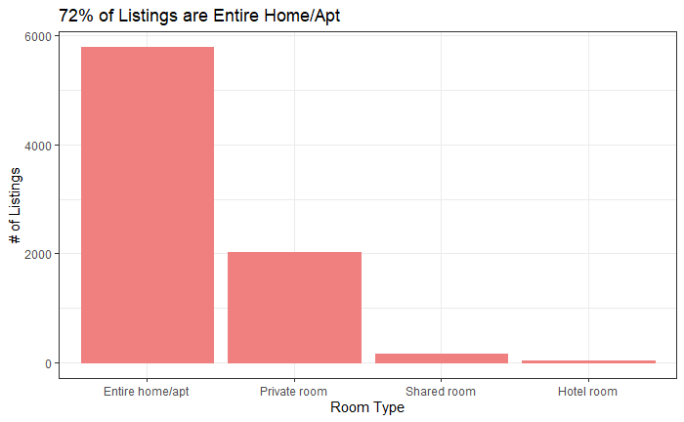
Which Room type has the most listings? (Regulations)

Slide 8
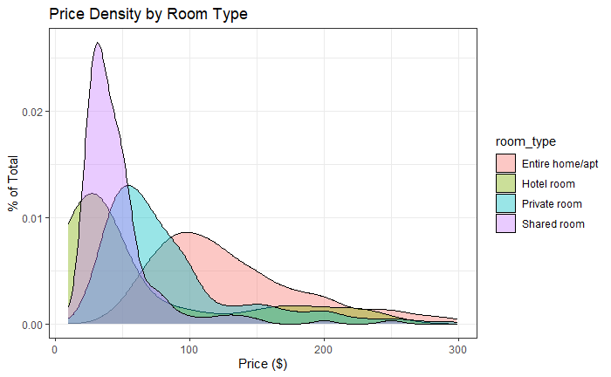
Let's look at the Property/Room Type and how it affects price distribution:

Slide 9
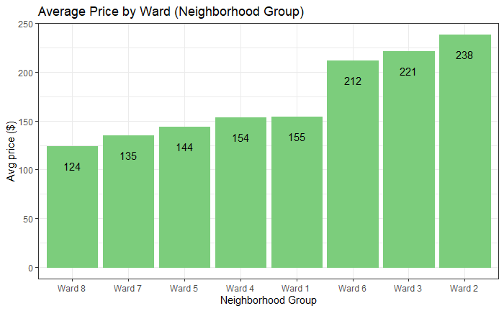
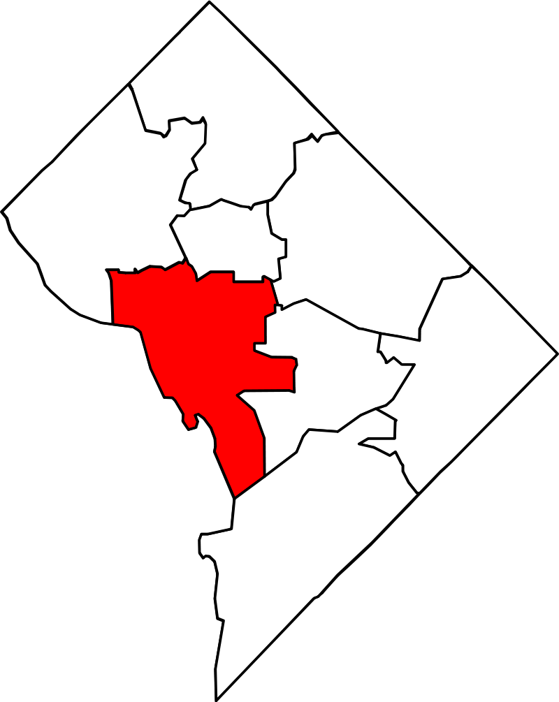
Now that we have ward info - a way to group the neighborhoods, let's see the average price by the ward:
From reading about D.C and knowing a little about certain parts of the city, this makes sense that the closer you get to the Downtown area(Ward 2) with the historic monuments and landmarks(Ward 2) along with affluent residential area(Ward 3) and government buildings(Ward 6) where most of the large events and public gatherings take place the pricier the listings get. On the other hand, Wards 5,7,8 are located furthest away from the Downtown area and can be shown to have the lowest average price per day from the graph above.

Slide 10
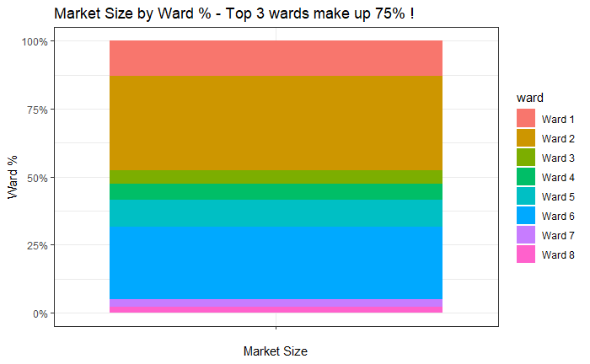
Let's see how much of the Market Size each Ward makes up - by multiplying the available days per year of each listing with its price and summing up by the ward:
It's interesting to see from the Market Size % Barchart that the top 3 wards - Wards 2, 6, and 1 - contribute 75% of the total Market size. These same 3 wards are located closest to the Downtown area of Washington D.C supporting the earlier trend seen in Average Price by Neighborhood Group Barplot.
Let's see if this emerging trend is related to Reviews

Slide 11
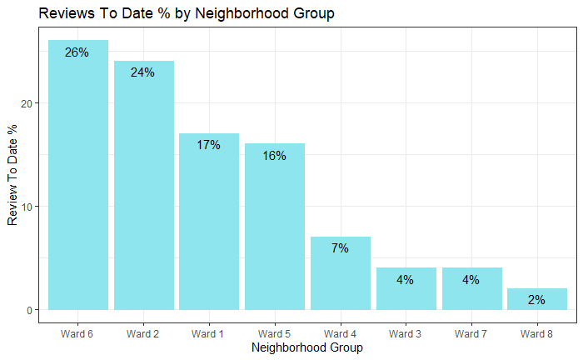
Reviews To Date
The same top 3 wards(Wards 6,2,1) that made up 75% of the total Market Size also account for 67% of All Reviews to date. This makes perfect sense as one would naturally expect most of the reviews to come from 3/4ths of the Market.
There are 2 kinds of review fields - 1st being number of reviews-to-date for the listing and the 2nd being reviews the listing has in the last 12 months.
This is actually quite important as the reviews-to-date field will represent how actively occupied and popular the listing has been ever since it has been active on the market which could be for years. Whereas for the reviews-in-the-last-12-months field will be more indicative of how likely the listing is currently to be in demand for bookings. Therefore the reviews field for the last 12 months will be used to compute the likelihood of listings to be in demand when compared to other listings.

Slide 12
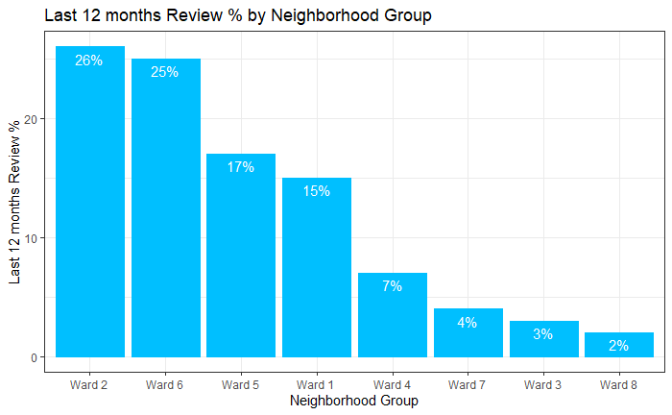
Let's see the trend for the Reviews of last 12 months by Neighborhood Group:
The last 12 months Review % shows that the most current reviews trends haven't changed much from the Reviews To Date as the top 4 wards have stayed the same contributing about the same % of the Reviews. Ward 5 has gone up a place by owning 2% more reviews in the last year compared to Ward 1 so this is good to know from a potential host standpoint.

Slide 13
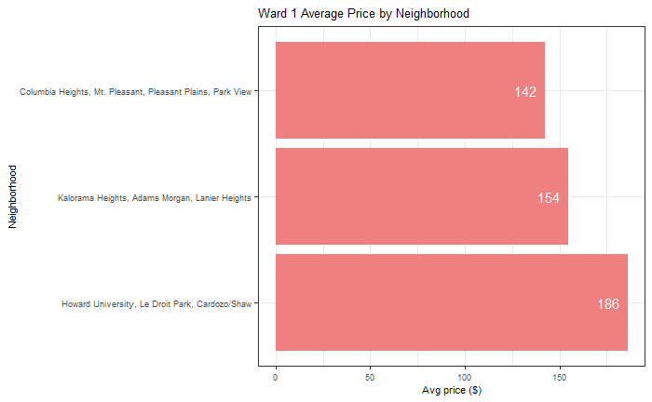
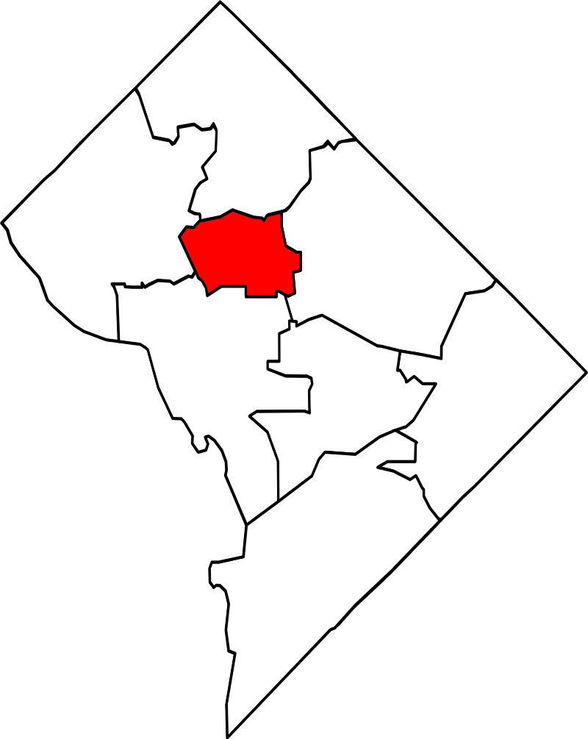
Answer to Question #1
Now that we have looked at the trends in Reviews, I can finally answer my 1st question of interest: As a potential guest, Ward 1 and Ward 5 (as a second option) seems to offer the most affordable price on average (potential savings of $83 per day) while being considerably frequently reviewed and located closest to the ward with the downtown area with all the historic landmarks.

Slide 14
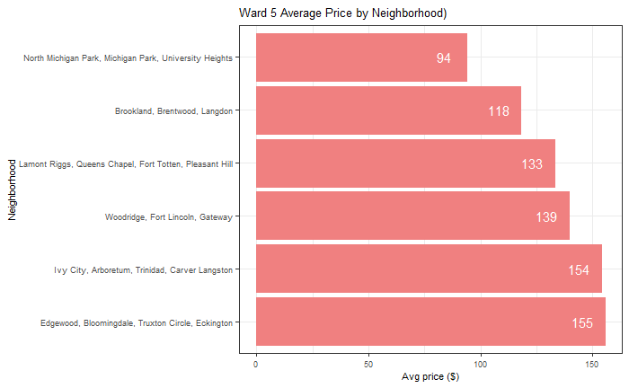
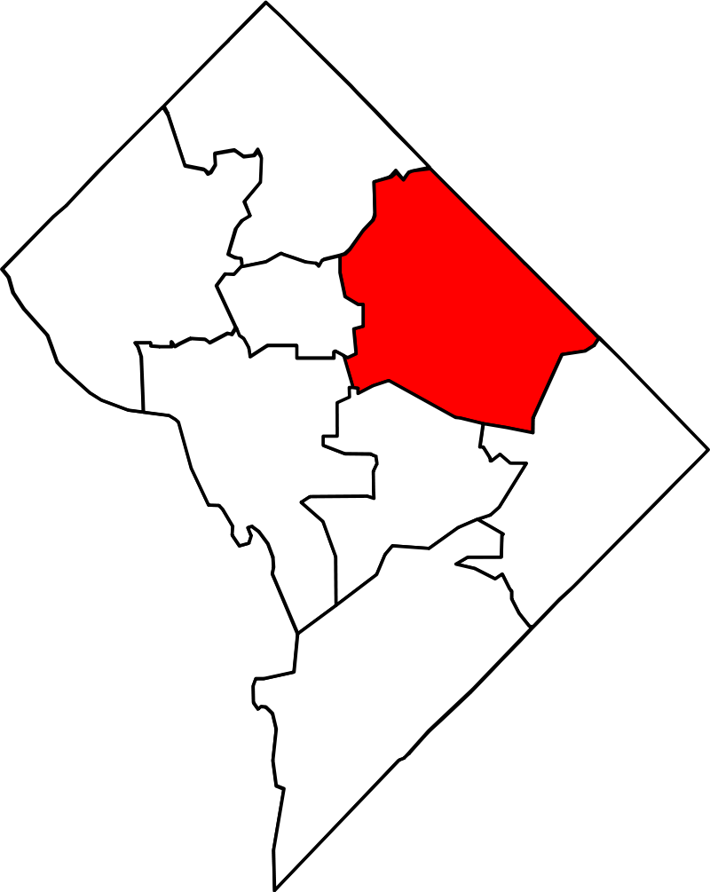
Ward 5 (Alternative Better option for guest):
Ward 1 and Ward 5 as a backup option also makes up a sizeable portion of the Market size which means potential guests will have enough variety listings to choose from. So here are the Neighborhoods in Ward 1 and Ward 5 that you can search to get a sweet deal showing their average daily price:

Slide 15
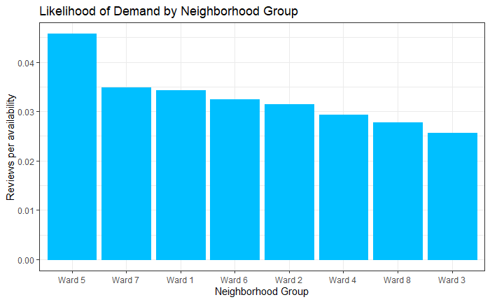
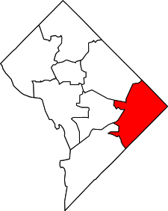
Determine the likelihood of a listing to be more in demand by taking the ratio between the last 12 month current Reviews and its availability by neighborhood group (ward).
Using the last 12 month review count as an indicator of likelihood of occupancy and the listing available days as a factor of meeting the market demand:
Here I can address the 2nd Question of my interest: Ward 5 and 1 would be the wards I would look into potentially put a listing because they have the highest likelihood for demand currently and they are good pick for people who are looking for affordable options compared to Downtown area listings which are more expensive. Ward 7 isn't recommended because it only makes up 3% of market size having less information to make an investment decision. However on the other hand I guess it could be an option due to less competition so we may keep an eye on it.

Slide 16
Next steps
Obtain data from previous years for better comparison and trends over the years
Build a predictive model to apply to new data
Complete the Shiny app with interactive Map features
Questions ?

